Slide 1
ONLINE CLASS
GRAPH THEORY
BICTE $6^{TH}$ SEMESTER
2078/03/22
PRESENTED BY KALYAN DAHAL

Slide 2
Eulerian graphs
Let G be graph. A closed trial or circuit consisting all the edges is called an Eulerian trial. A graph having an Eulerian trial is called an Eulerian graph.
Notes:
It needs to have every vertex with even degree for the existence of Eulerian circuit.
The Konigsberg bridge's graph has no Eulerian circuit as none of it vertex has even degree.
As the Eulerian circuit contains all the edges it prefers generally multigraphs than graphs

Slide 3
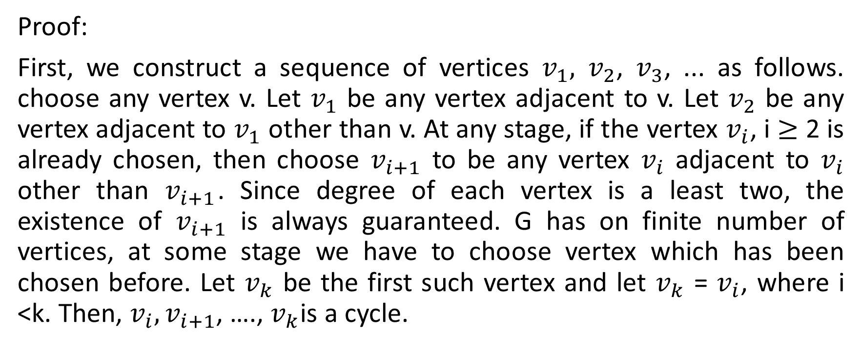
If G is a graph in which the degree of every vertex is at least two then G contains a cycle.
Proof:
First, we construct a sequence of vertices $v_{1},$ $v_{2}$, $v_{3}$, ... as follows. choose any vertex v. Let $v_{1}$ be any vertex adjacent to v. Let $v_{2}$ be any vertex adjacent to $v_{1}$ other than v. At any stage, if the vertex $v_{i}$, i $≥$ 2 is already chosen, then choose $v_{i+1}$ to be any vertex $v_{i}$ adjacent to $v_{i}$ other than $v_{i+1}$. Since degree of each vertex is a least two, the existence of $v_{i+1}$ is always guaranteed. G has on finite number of vertices, at some stage we have to choose vertex which has been chosen before. Let $v_{k}$ be the first such vertex and let $v_{k}$ = $v_{i}$, where i <k. Then, $v_{i},v_{i+1}$, …., $v_{k}$is a cycle.

Slide 4
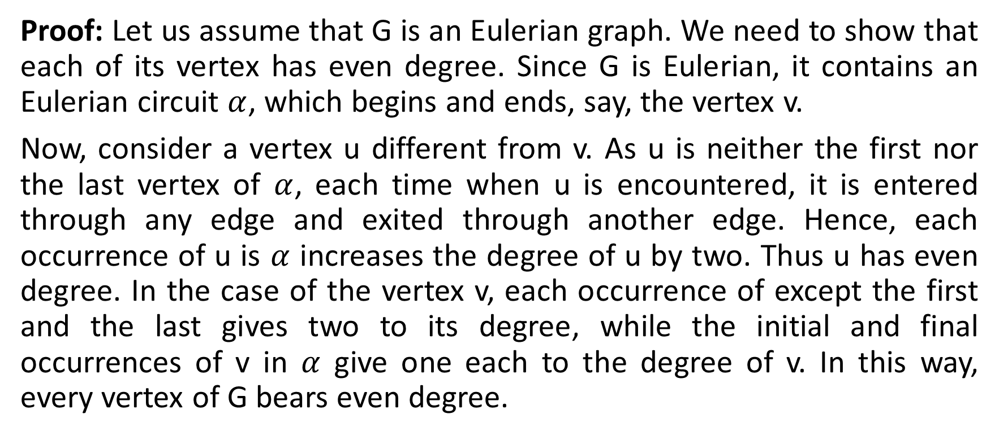
A connected graph G is Eulerian if and only if each vertex has even degree.
Proof: Let us assume that G is an Eulerian graph. We need to show that each of its vertex has even degree. Since G is Eulerian, it contains an Eulerian circuit $α$, which begins and ends, say, the vertex v.
Now, consider a vertex u different from v. As u is neither the first nor the last vertex of $α$, each time when u is encountered, it is entered through any edge and exited through another edge. Hence, each occurrence of u is $α$ increases the degree of u by two. Thus u has even degree. In the case of the vertex v, each occurrence of except the first and the last gives two to its degree, while the initial and final occurrences of v in $α$ give one each to the degree of v. In this way, every vertex of G bears even degree.

Slide 5
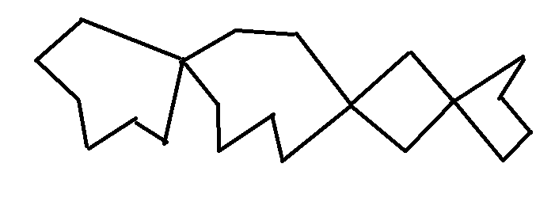
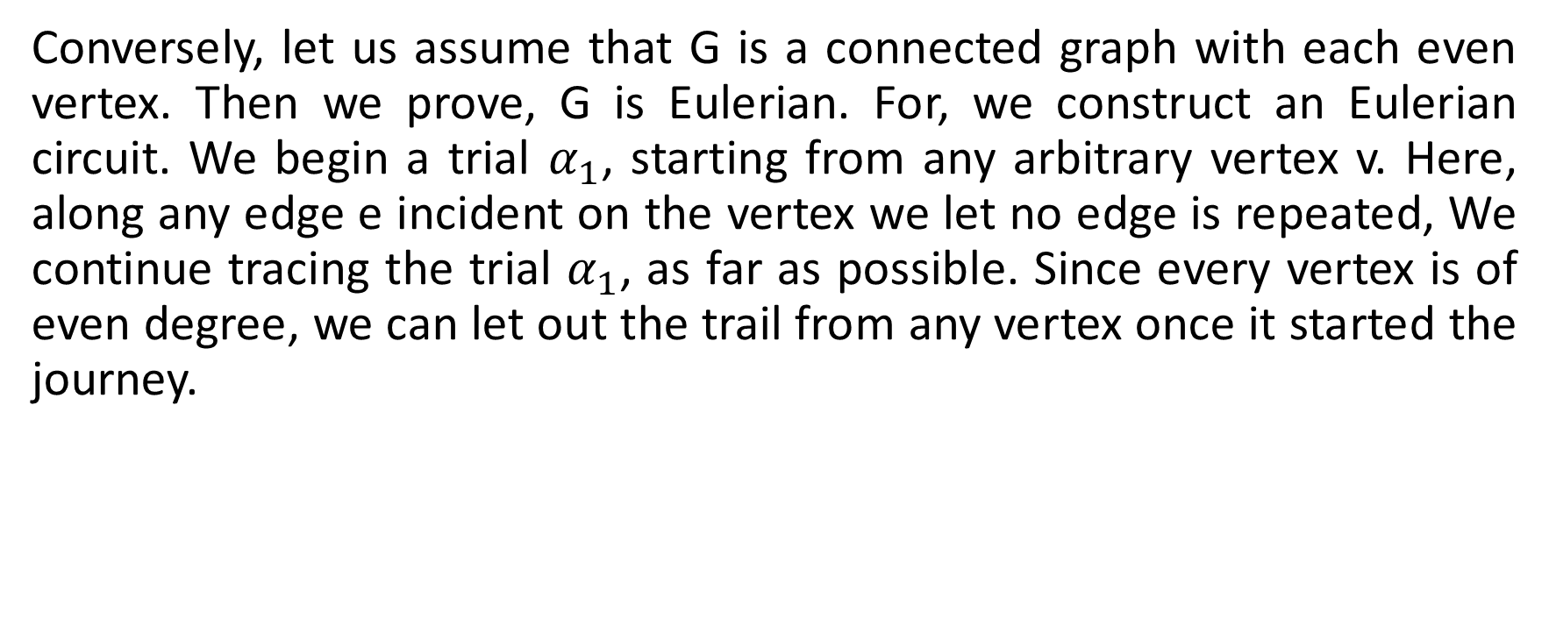


Continued….
Conversely, let us assume that G is a connected graph with each even vertex. Then we prove, G is Eulerian. For, we construct an Eulerian circuit. We begin a trial $α_{1}$, starting from any arbitrary vertex v. Here, along any edge e incident on the vertex we let no edge is repeated, We continue tracing the trial $α_{1}$, as far as possible. Since every vertex is of even degree, we can let out the trail from any vertex once it started the journey.
$$e_{1}$$
$$u_{1}$$

Slide 6
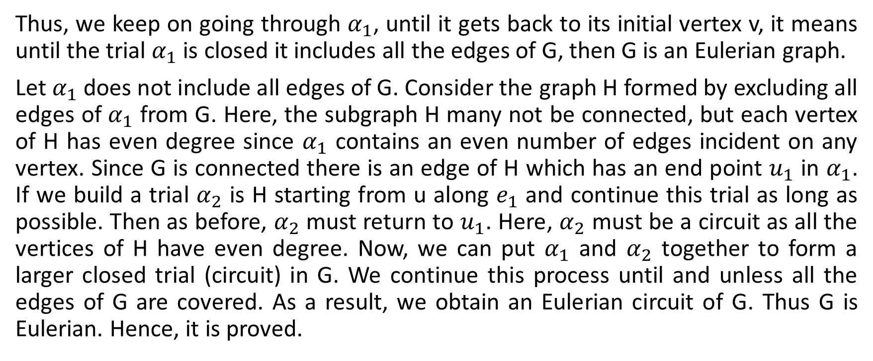
Continued….
Thus, we keep on going through $α_{1}$, until it gets back to its initial vertex v, it means until the trial $α_{1}$ is closed it includes all the edges of G, then G is an Eulerian graph.
Let $α_{1}$ does not include all edges of G. Consider the graph H formed by excluding all edges of $α_{1}$ from G. Here, the subgraph H many not be connected, but each vertex of H has even degree since $α_{1}$ contains an even number of edges incident on any vertex. Since G is connected there is an edge of H which has an end point $u_{1}$ in $α_{1}$. If we build a trial $α_{2}$ is H starting from u along $e_{1}$ and continue this trial as long as possible. Then as before, $α_{2}$ must return to $u_{1}$. Here, $α_{2}$ must be a circuit as all the vertices of H have even degree. Now, we can put $α_{1}$ and $α_{2}$ together to form a larger closed trial (circuit) in G. We continue this process until and unless all the edges of G are covered. As a result, we obtain an Eulerian circuit of G. Thus G is Eulerian. Hence, it is proved.

Slide 7
Eulerian trial
A trial in a graph G is said to be an Eulerian trial if it covers every edge of G. Then G is called the traversable graph. Thus, the Eulerian trial includes each and every edge of G exactly once.
Note:
Eulerian trial is open.
Eulerian circuit is closed as it has initial and terminal vertices are same.
Eulerian circuit and trial both permit repetition of vertices.
Both of them are not permitted to leave any edge so all edges must be involved on them.

Slide 8
A multi graph G is traversable if and only if G is connected and has exactly two odd vertices.
Proof:
We assume that multigraph G is a traversable graph. Then, there is an Eulerian trial in G. Thus, G has a trial containing all the vertices and edges of G. It follows that G is connected and it has exactly two odd vertices.
Conversely, we consider a connected multi graph G has exactly two odd vertices, say, u and v. Then it needs to be prove that G is a traversable graph. We insert an edge e in G so that G' = G U {e} as shown in the figure.

Slide 9
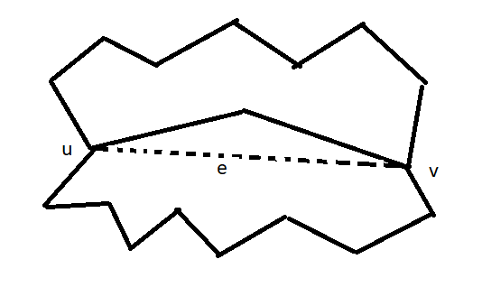
Continued……

Slide 10
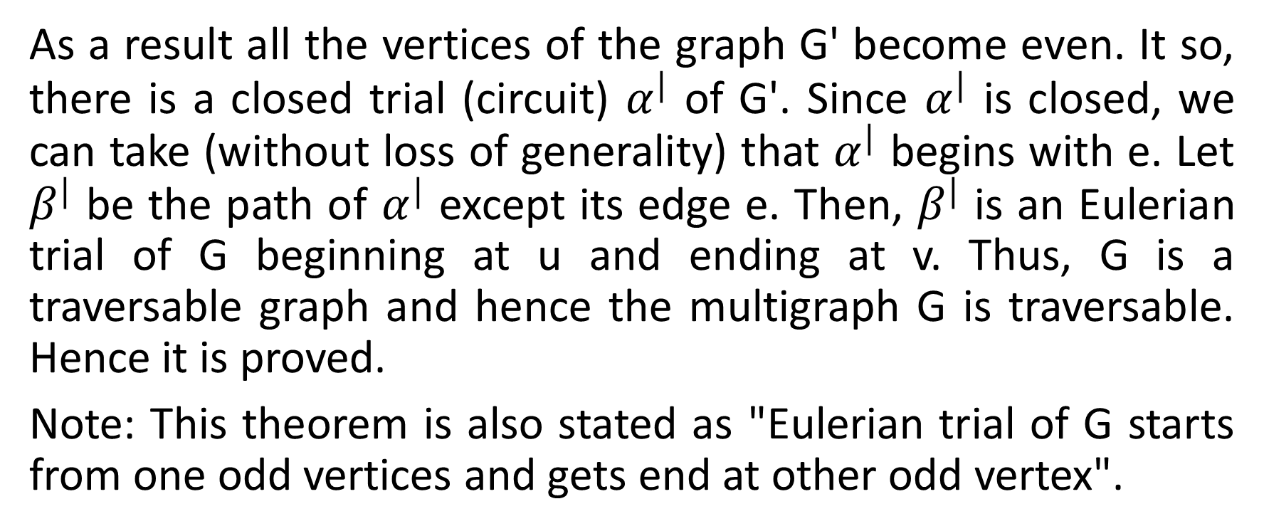
Continued….
As a result all the vertices of the graph G' become even. It so, there is a closed trial (circuit) $α^{|}$ of G'. Since $α^{|}$ is closed, we can take (without loss of generality) that $α^{|}$ begins with e. Let $β^{|}$ be the path of $α^{|}$ except its edge e. Then, $β^{|}$ is an Eulerian trial of G beginning at u and ending at v. Thus, G is a traversable graph and hence the multigraph G is traversable. Hence it is proved.
Note: This theorem is also stated as "Eulerian trial of G starts from one odd vertices and gets end at other odd vertex".

Slide 11
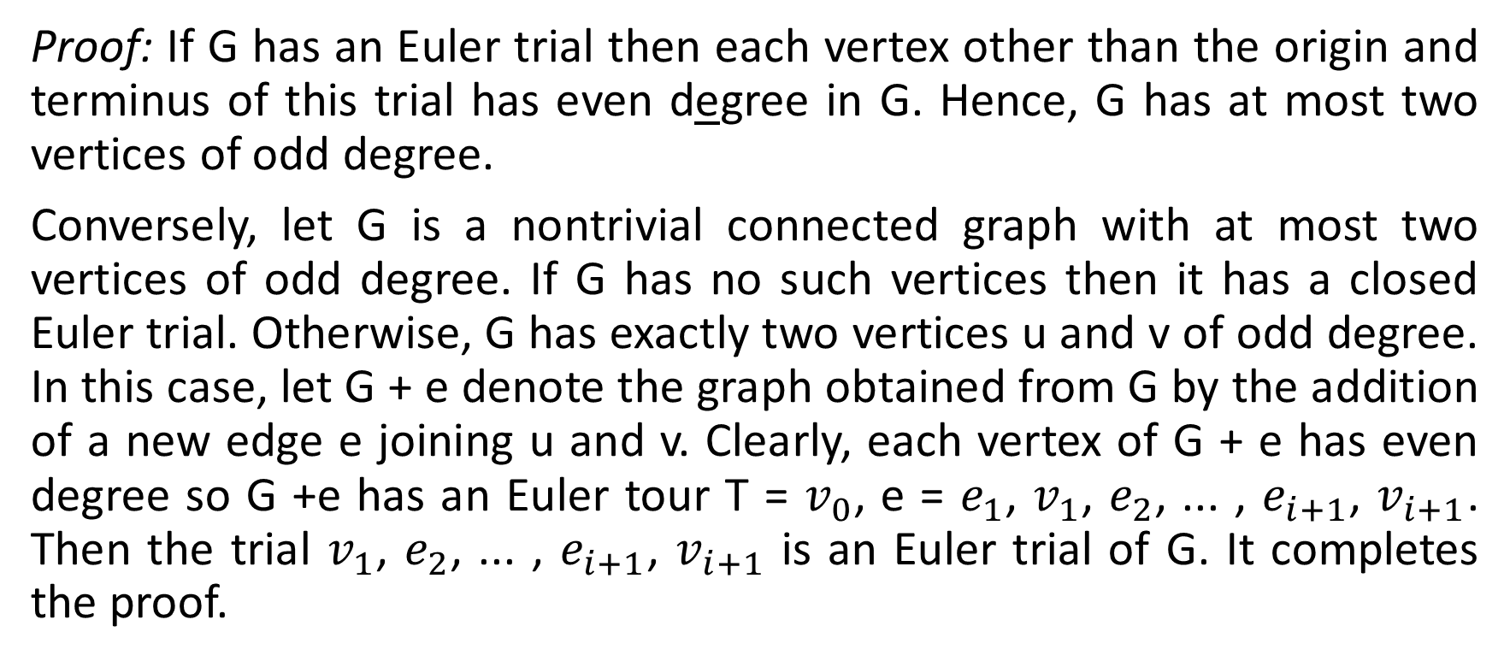
A connected graph has an Euler trail if and only if it has at most two vertices of odd degree.
Proof: If G has an Euler trial then each vertex other than the origin and terminus of this trial has even degree in G. Hence, G has at most two vertices of odd degree.
Conversely, let G is a nontrivial connected graph with at most two vertices of odd degree. If G has no such vertices then it has a closed Euler trial. Otherwise, G has exactly two vertices u and v of odd degree. In this case, let G + e denote the graph obtained from G by the addition of a new edge e joining u and v. Clearly, each vertex of G + e has even degree so G +e has an Euler tour T = $v_{0}$, e = $e_{1}$, $v_{1}$, $e_{2}$, ... , $e_{i+1}$, $v_{i+1}$. Then the trial $v_{1}$, $e_{2}$, ... , $e_{i+1}$, $v_{i+1}$ is an Euler trial of G. It completes the proof.

Slide 12
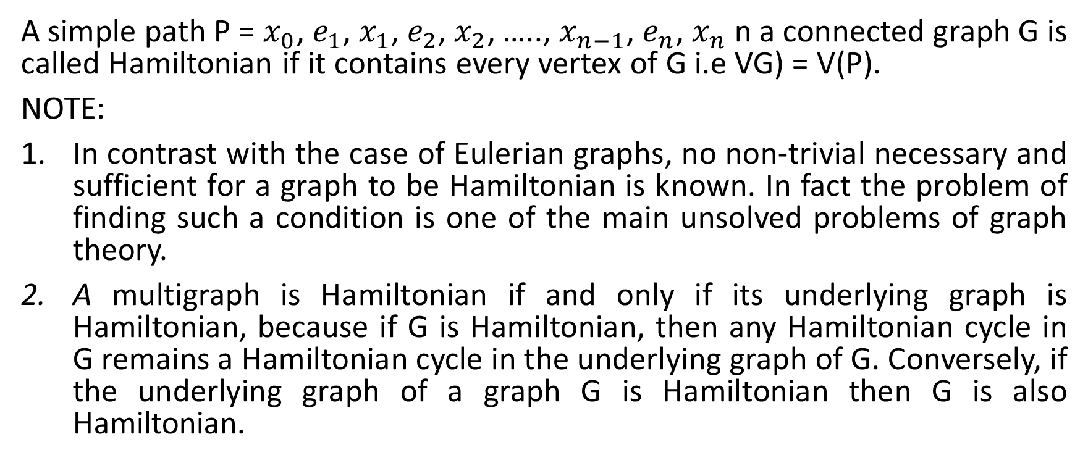
Hamiltonian graph
A simple path P = $x_{0}$, $e_{1}$, $x_{1}$, $e_{2}$, $x_{2}$, ….., $x_{n−1}$, $e_{n}$, $x_{n}$ n a connected graph G is called Hamiltonian if it contains every vertex of G i.e VG) = V(P).
NOTE:
In contrast with the case of Eulerian graphs, no non-trivial necessary and sufficient for a graph to be Hamiltonian is known. In fact the problem of finding such a condition is one of the main unsolved problems of graph theory.
A multigraph is Hamiltonian if and only if its underlying graph is Hamiltonian, because if G is Hamiltonian, then any Hamiltonian cycle in G remains a Hamiltonian cycle in the underlying graph of G. Conversely, if the underlying graph of a graph G is Hamiltonian then G is also Hamiltonian.

Slide 13
Hamiltonian cycle
A cycle containing every vertex of a graph G is said to be a Hamiltonian cycle. It is also called a Hamiltonian circuit
Note:
No vertex of a Hamiltonian cycle is repeated except the first and final vertices which are the same.
A graph G is called Hamiltonian if it has a Hamiltonian cycle.
The figure of dodecahedron is Hamiltonian.
Hamiltonian cycle neither include every edge nor repeat vertices but Eulerian circuit include every edge and allow to repeat vertices.
The Hamiltonian cycle and path are of length n and (n-1) respectively.

Slide 14

Every Hamilton graph is 2-connected.
Proof: Let G be a Hamilton graph and let C be a Hamilton cycle in G. For any vertex v of G, C-v is connected and hence G-v is also connected.
Hence, G has no cut points and therefore, G is 2-connected.
Note: The bipartite graph $K_{m, n}$ is non Hamiltonian.

Slide 15


